Slide 1
Simulation Setup for Scaled Autonomous Vehicles
AuE-8360 Scaled Autonomous Vehicles
Chinmay Samak
PhD Candidate, CU-ICAR
csamak@clemson.edu
Tanmay Samak
PhD Candidate, CU-ICAR
tsamak@clemson.edu

Slide 2
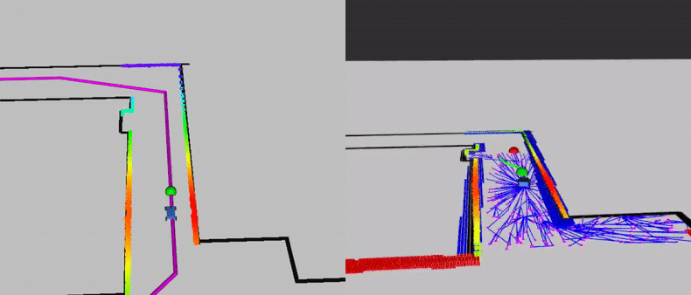
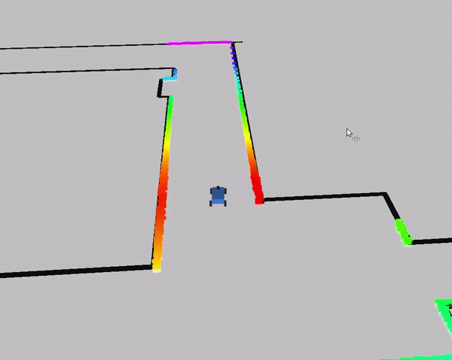

Official F1TENTH Simulator - Introduction
Advantages
Open source
Simple & intuitive
Uses same stack as real vehicle
Disadvantages
2D simplistic simulation (RViz)
No vertical/roll/pitch dynamics
2D environment representation
No cross-platform support
Inaccuracies (e.g., 360° LIDAR simulation - real is 270°)
Simulation Quality | Physics Engine | Graphics Rendering | Vehicle Dynamics Support | Sensor Support | API Support | Developer | Cost | Open Source | Applications
2D | Custom (single track dynamics) | RViz | Single-track dynamics | 2D LIDAR | ROS, ROS 2, Autoware | UPenn | Free | Yes | Exploration, understanding, course, competition
Source: F1TENTH

Slide 3
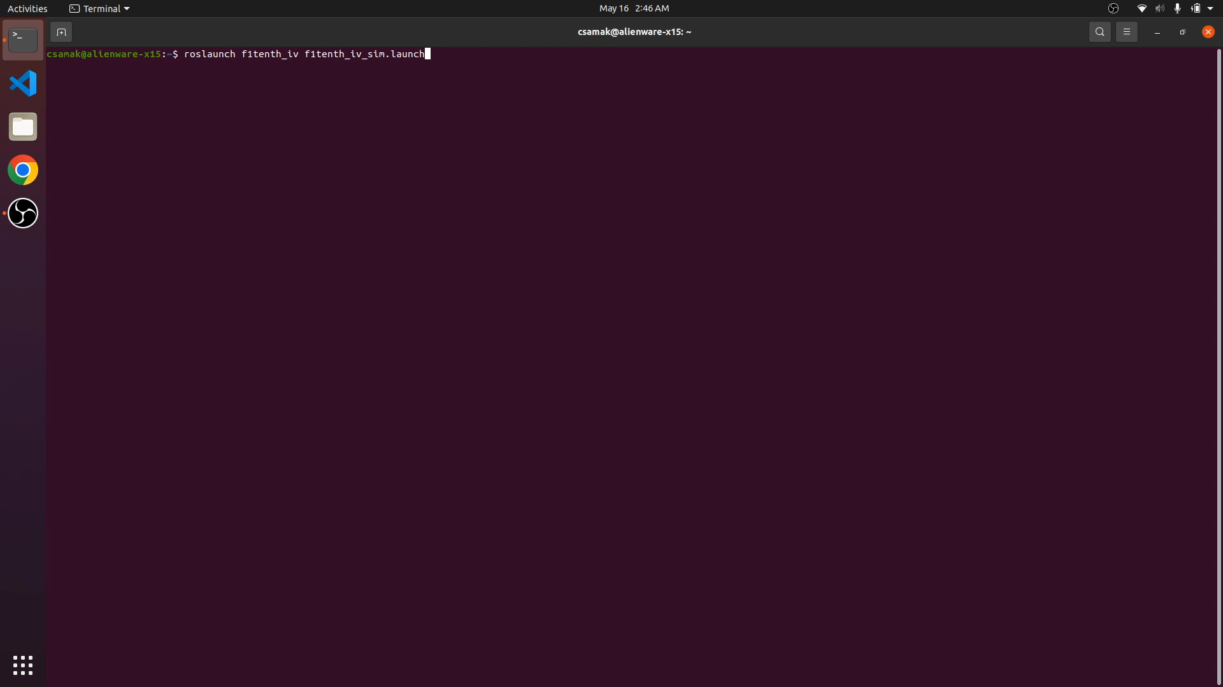
Official F1TENTH Simulator - Setup & Exploration

Slide 4
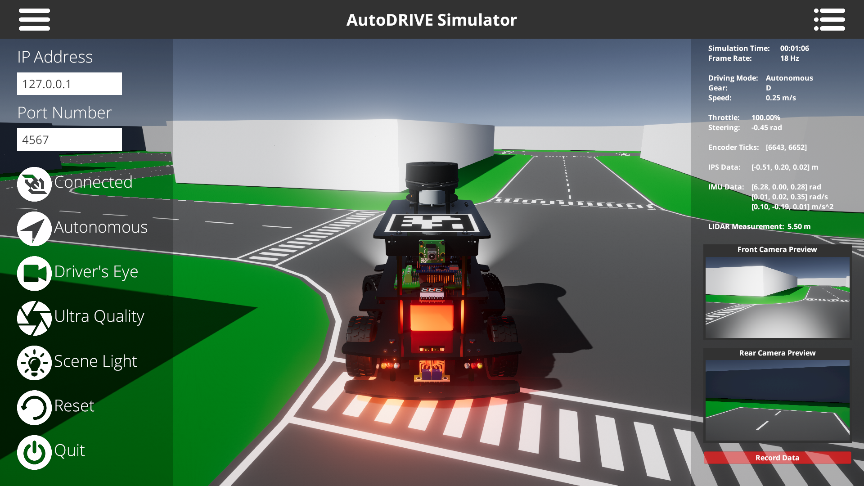
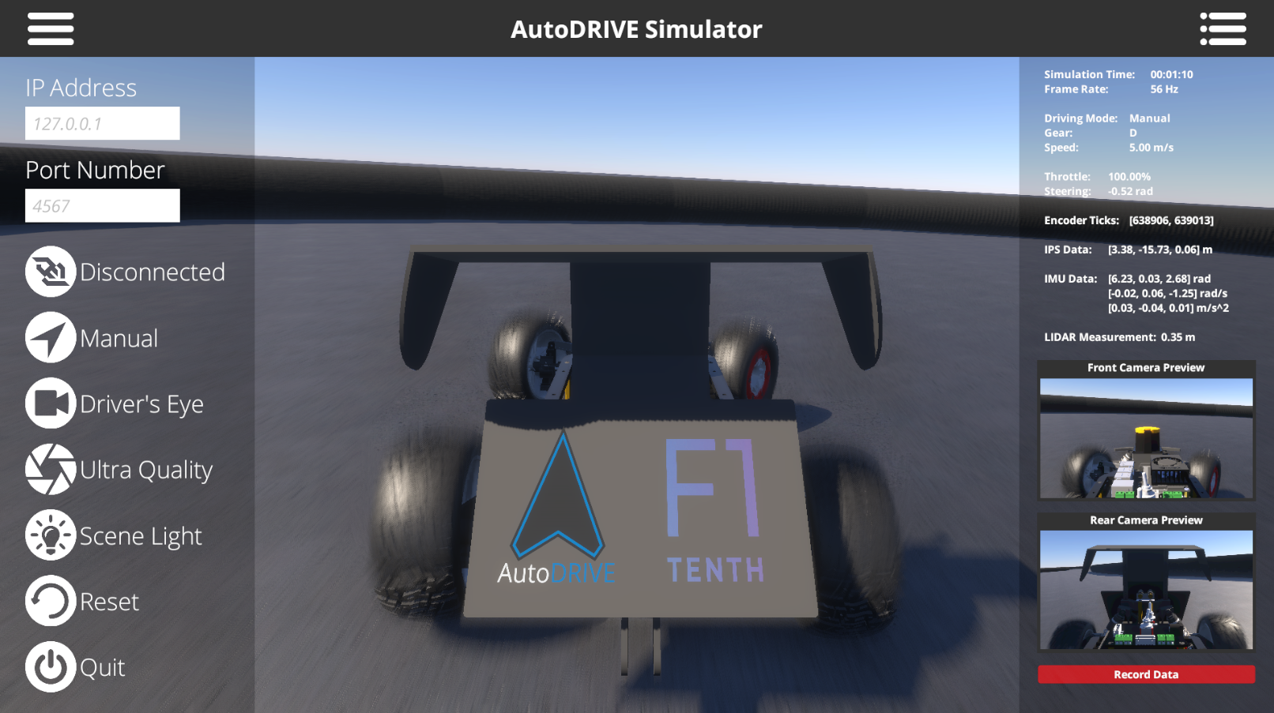

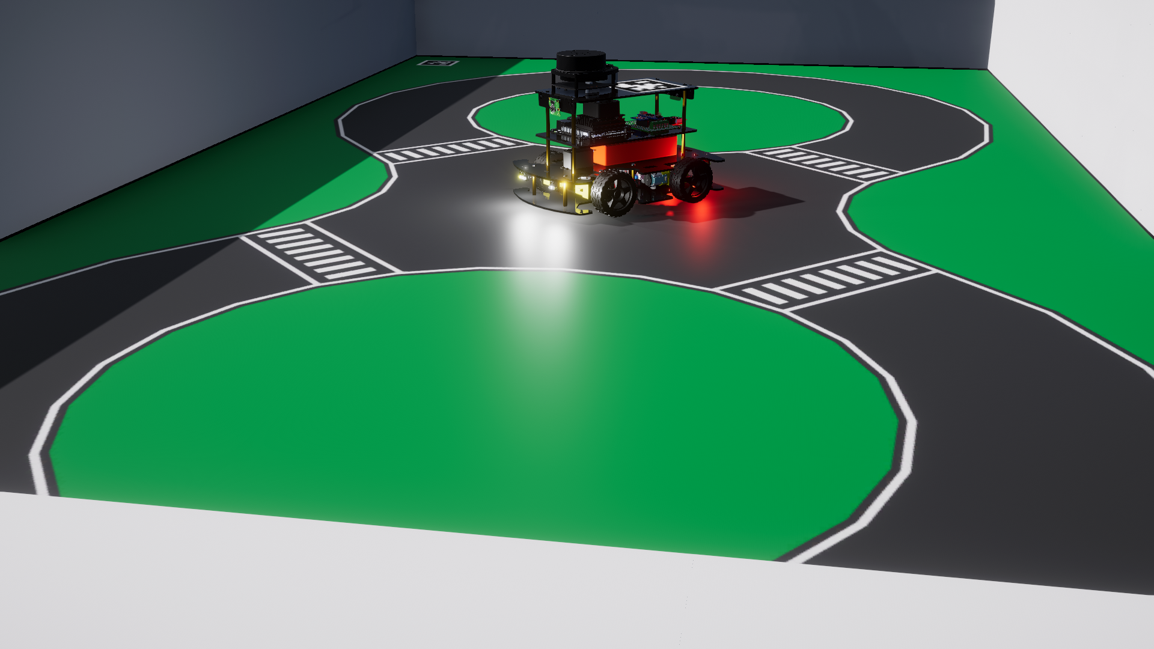
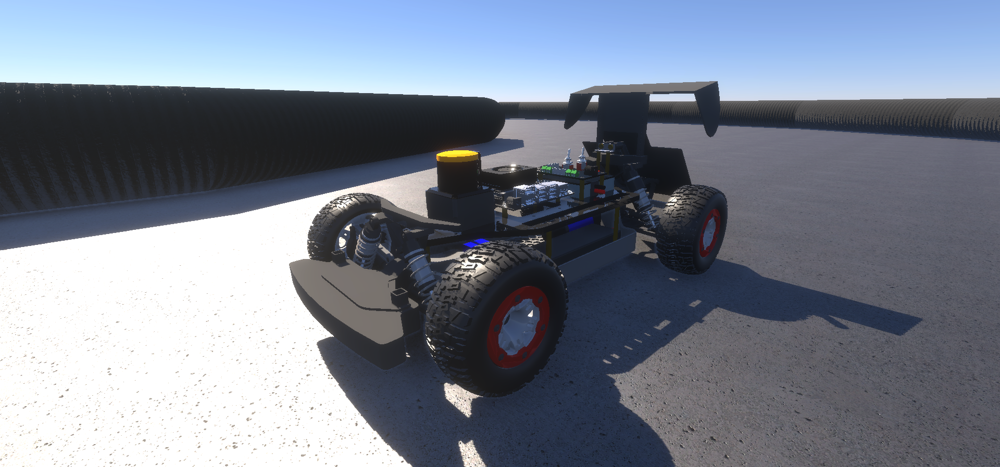
AutoDRIVE Simulator - Introduction
Advantages
3D simulation environment
Photorealistic graphics
Realistic physics
Cross-platform support
Extended API support
On/off road AVs across scales
Disadvantages
Moderate compute requirements
Small development team
Source: AutoDRIVE Ecosystem
Simulation Quality | Physics Engine | Graphics Rendering | Vehicle Dynamics Support | Sensor Support | API Support | Developer | Cost | Open Source | Applications
3D | PhysX | Unity HDRP | Full car model for lateral, longitudinal, vertical and RPY dynamics with tire-terrain interaction | 2D/3D LIDAR, Camera, GNSS, IPS, IMU, Encoders Steering Feedback, Throttle Feedback, State Variables | ROS, ROS 2, Python, C++, MATLAB, Simulink, Webapp | CU-ICAR, NTU, SRMIST | Free | Yes | Exploration, education and research

Slide 5
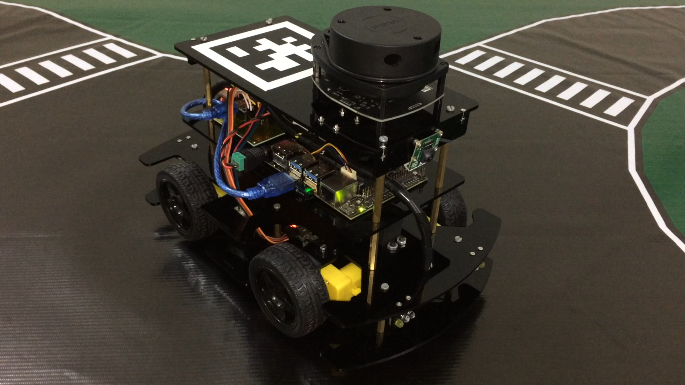
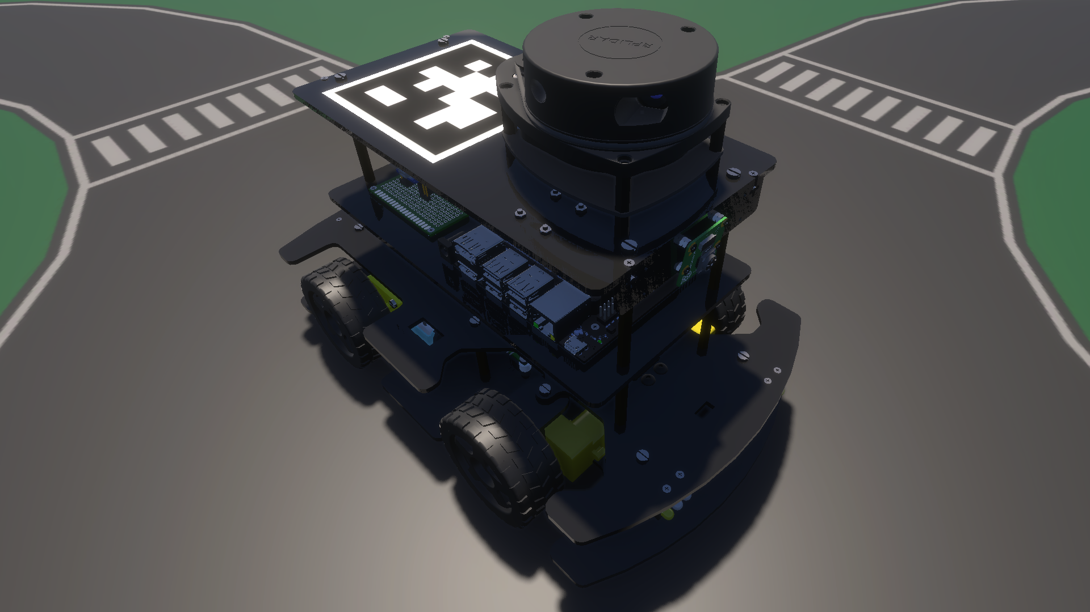
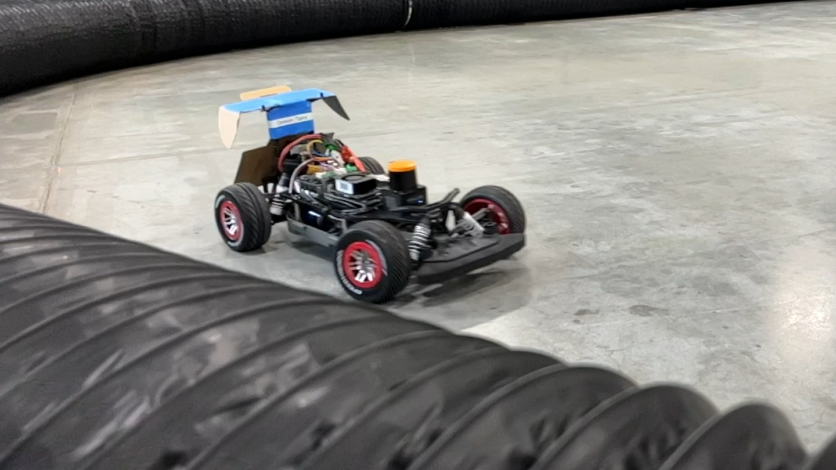
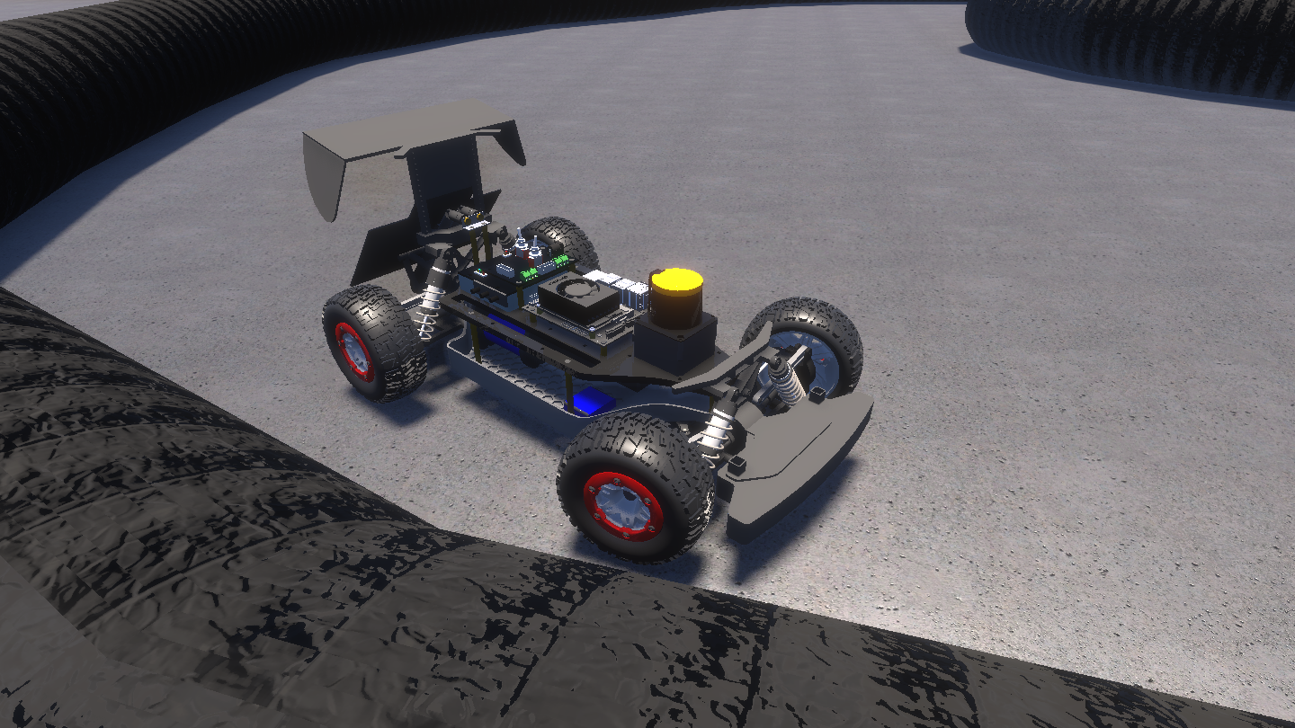
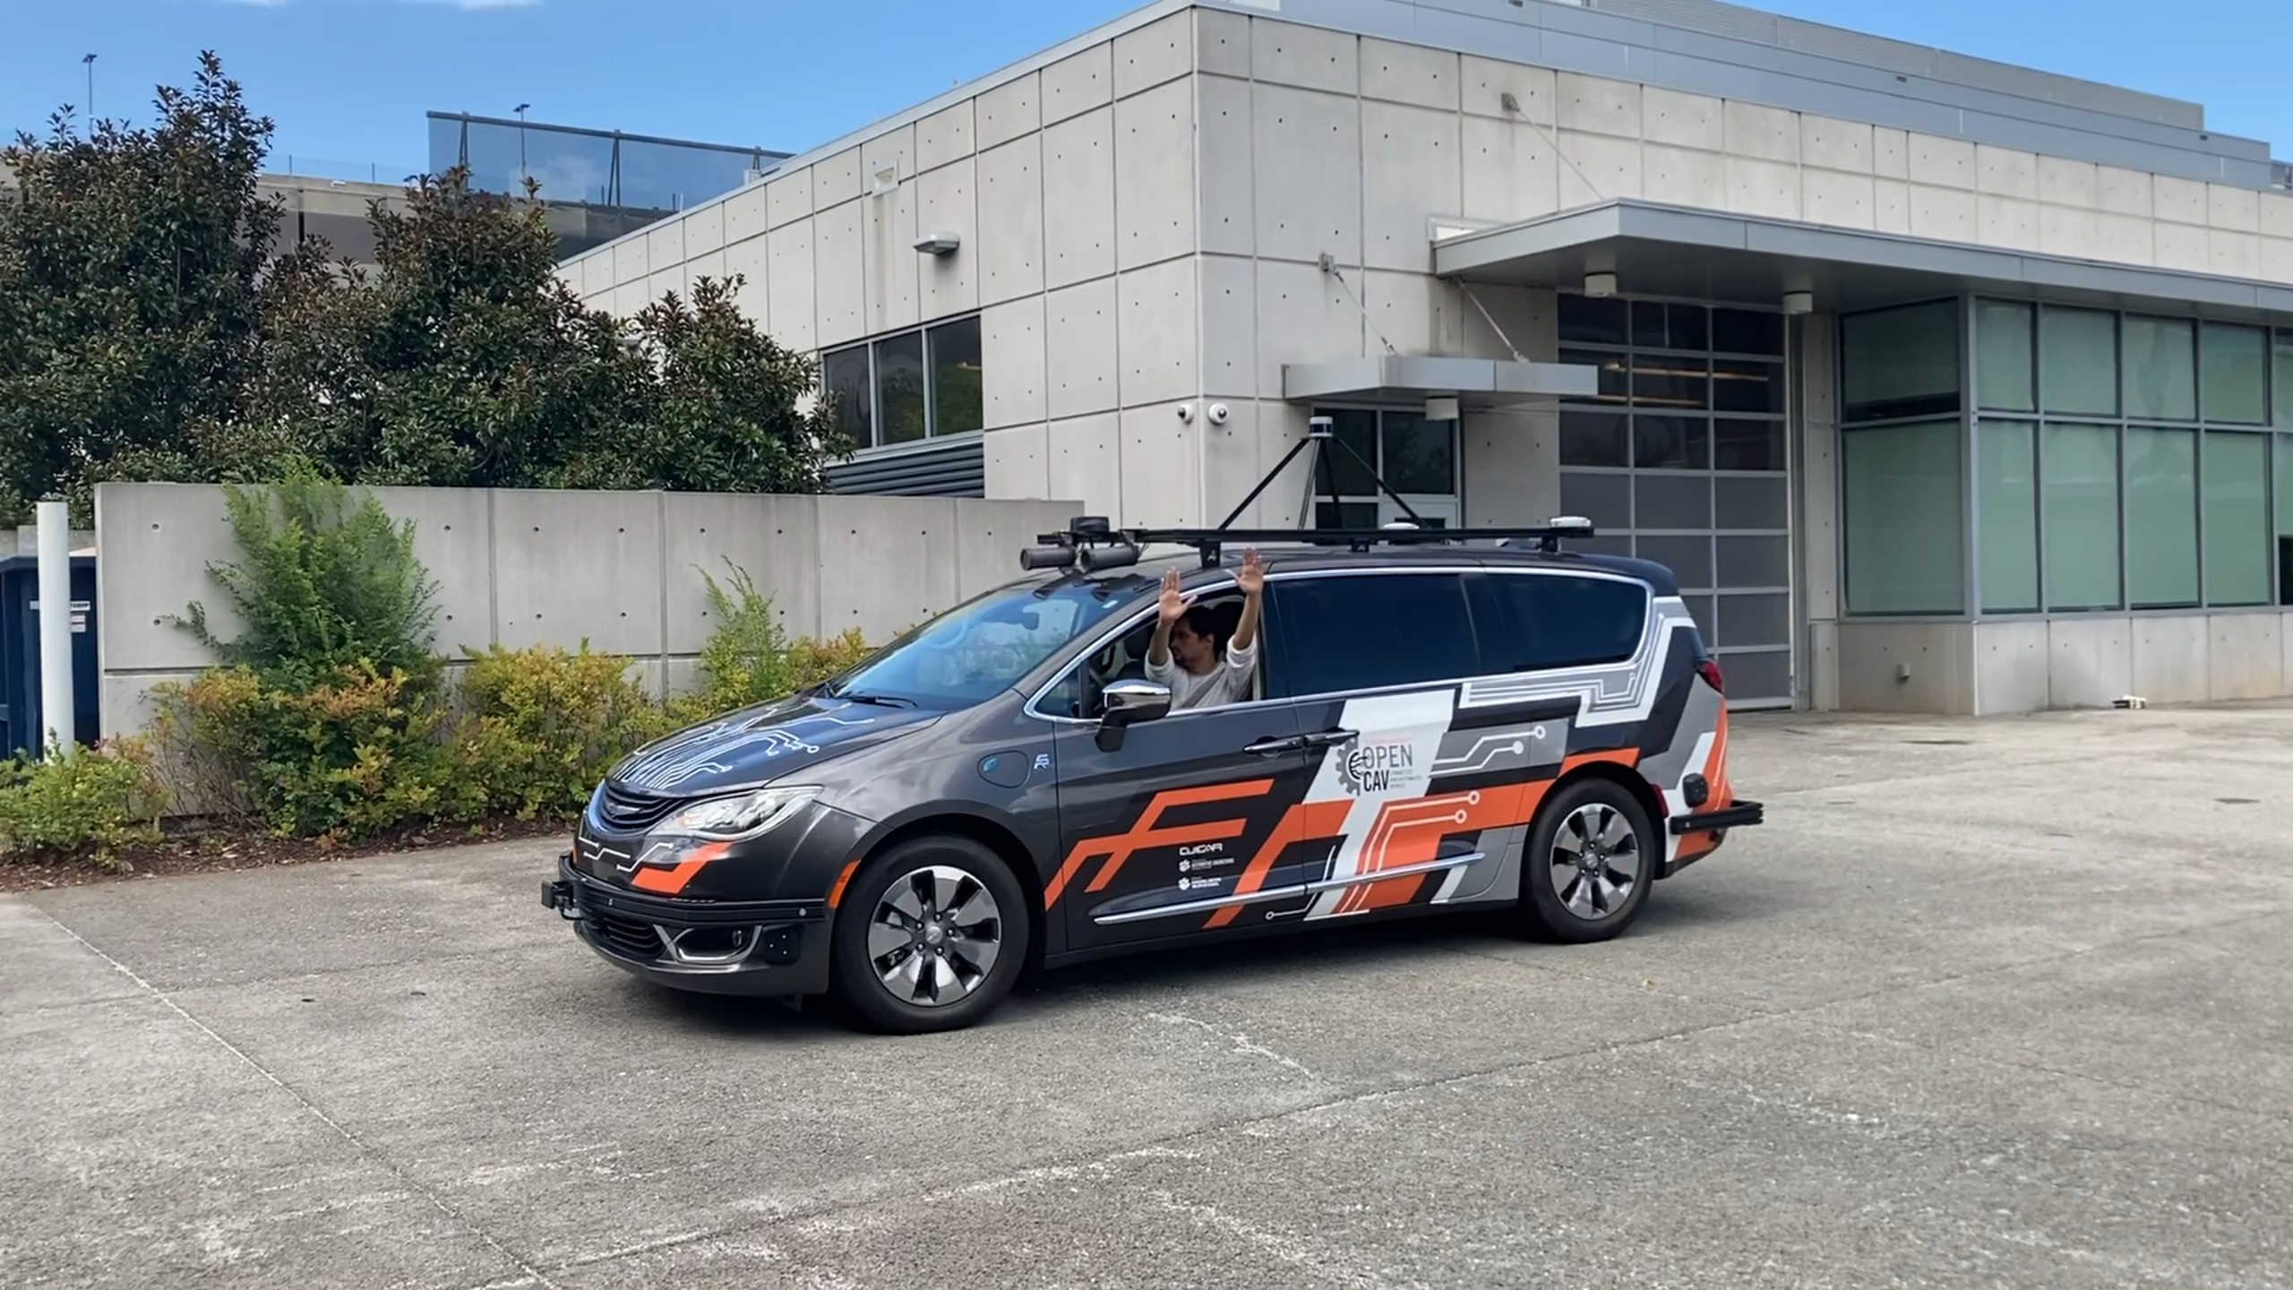
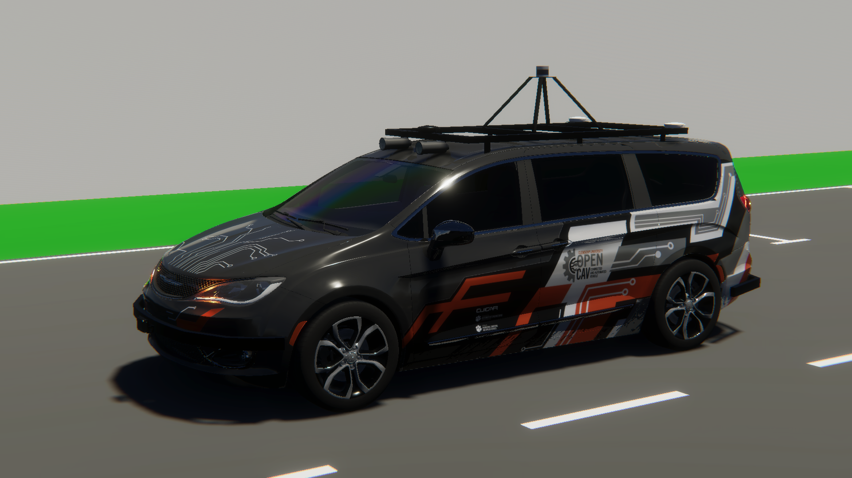
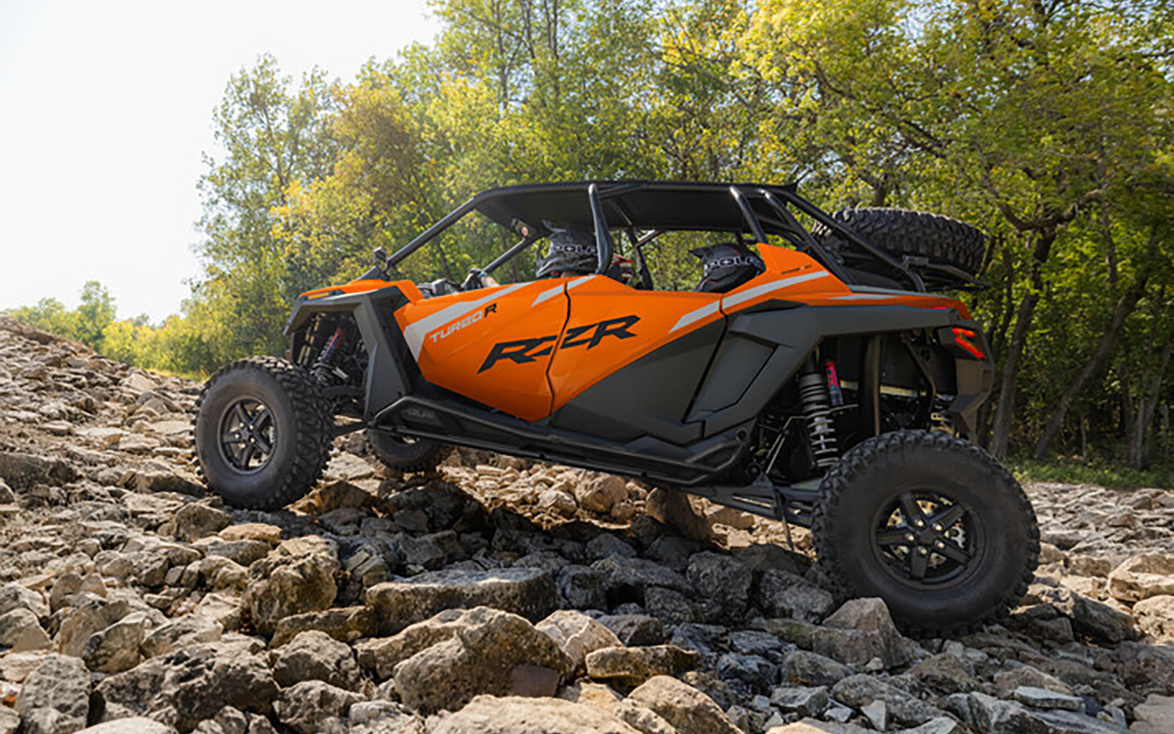
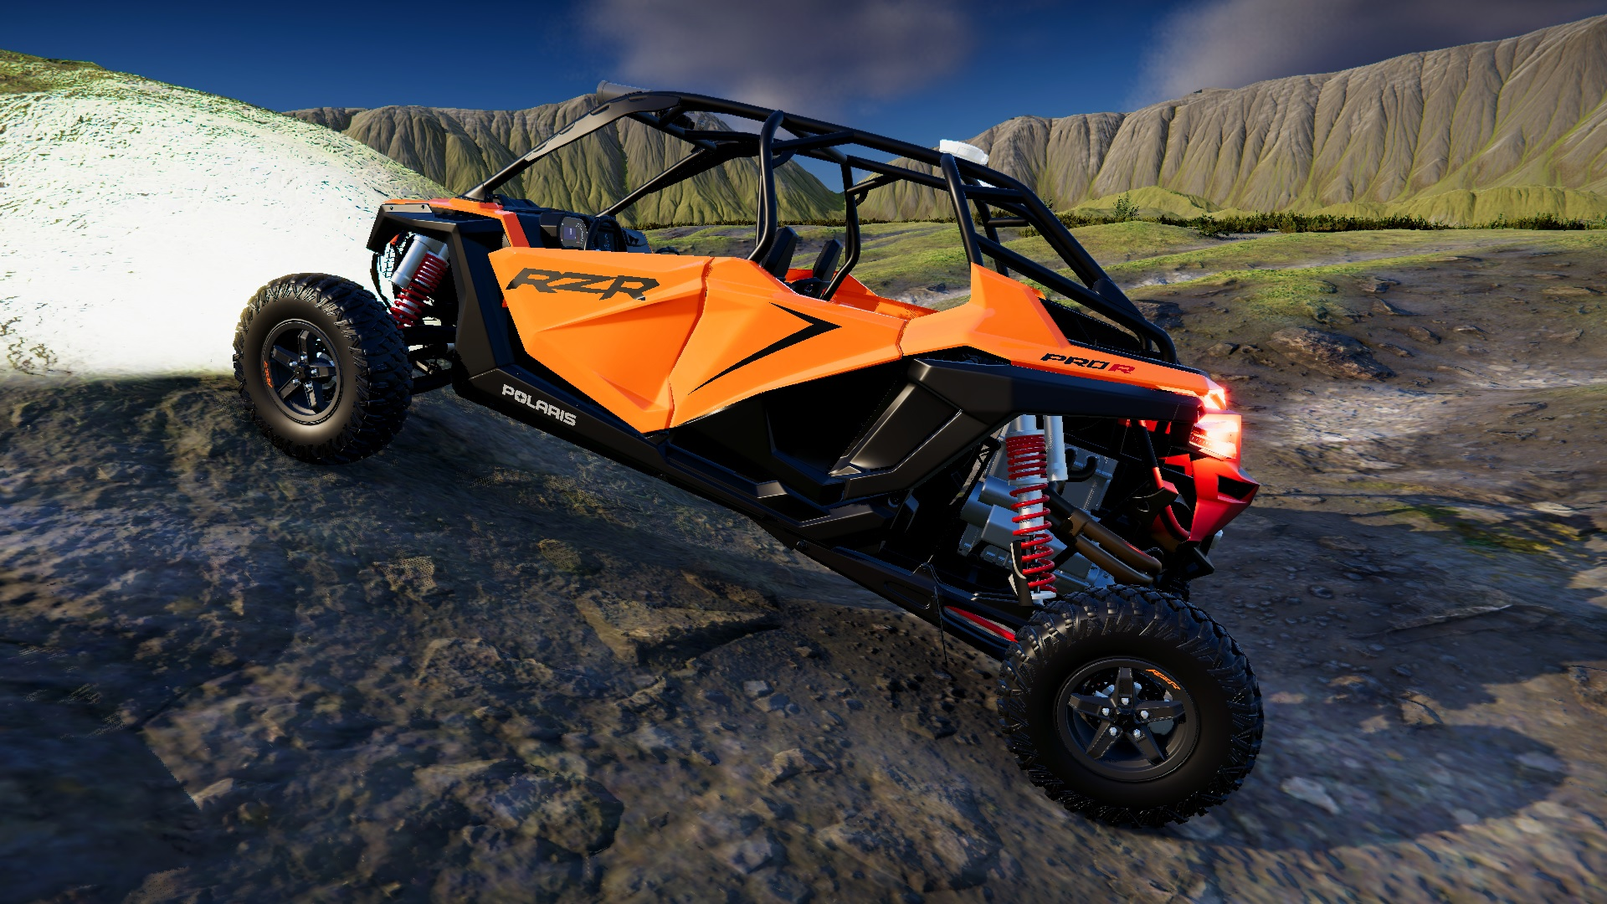
AutoDRIVE Simulator - Digital Twin Capabilities
Nigel (Native Scaled Vehicle)
F1TENTH (Scaled Vehicle)
OpenCAV (On-Road Full Scale Vehicle)
RZR (Off-Road Full Scale Vehicle)
Source: AutoDRIVE Ecosystem

Slide 6
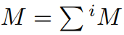
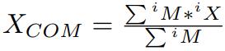
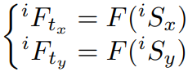
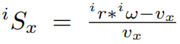
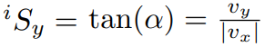
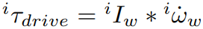
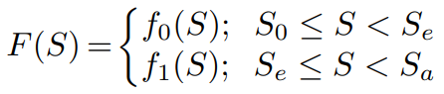
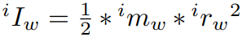
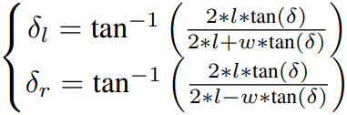
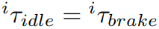
AutoDRIVE Simulator - F1TENTH Simulation
Vehicle dynamics
Rigid-body dynamics
Suspension dynamics
Tire dynamics
Actuator dynamics

Slide 7
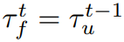
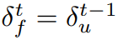
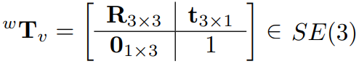
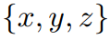
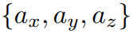
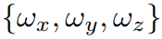
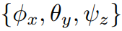
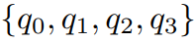
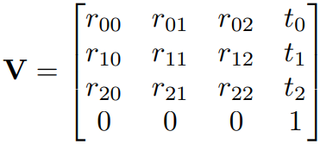
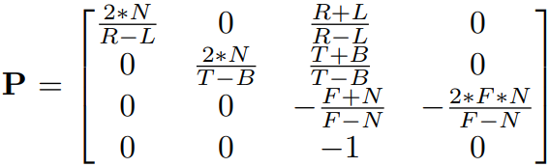
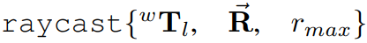
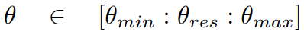
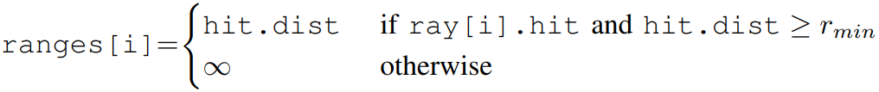
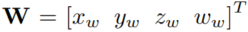
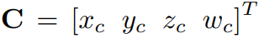
AutoDRIVE Simulator - F1TENTH Simulation
Sensor physics
LIDAR
Throttle & steering sensors*
Incremental encoders*
Indoor positioning system*
Inertial measurement unit*
Cameras*

Slide 8
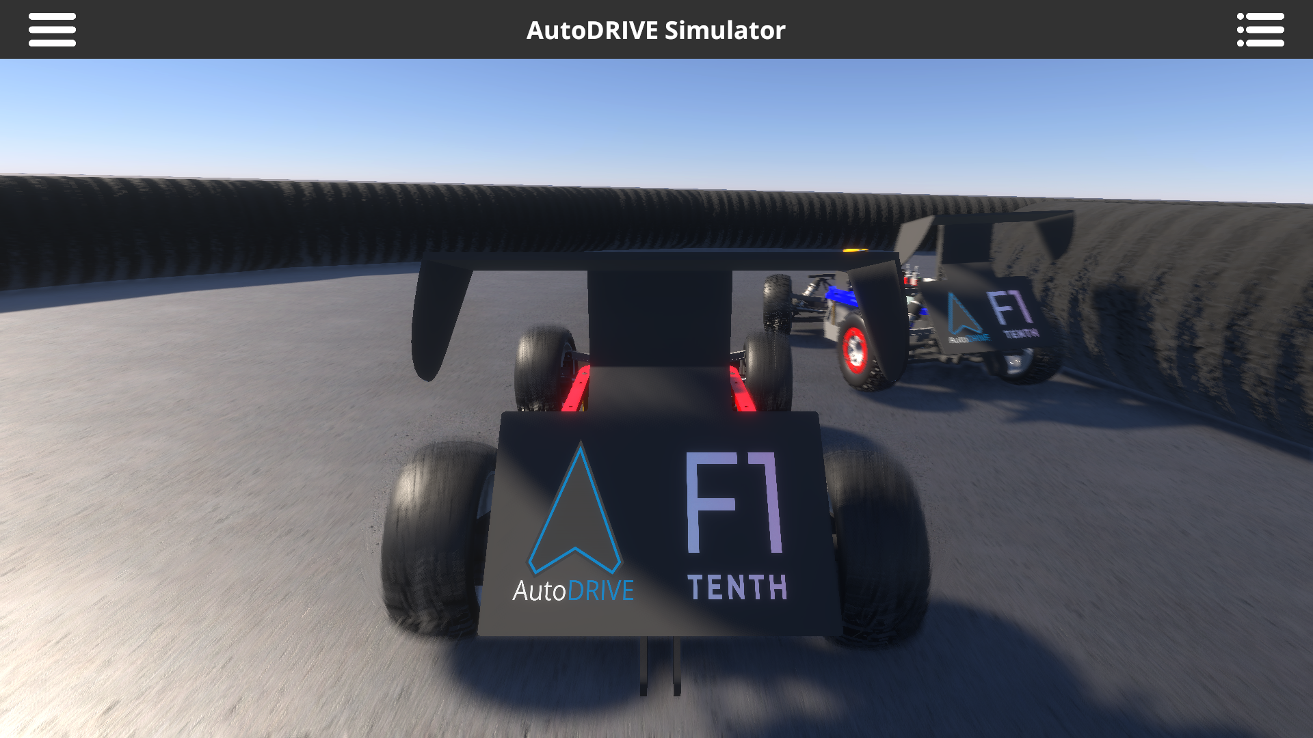
AutoDRIVE Simulator - F1TENTH Simulation

Slide 9
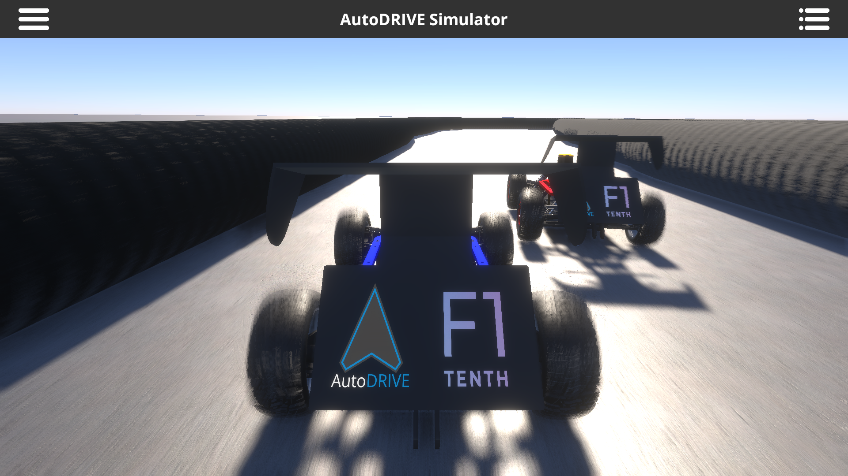
AutoDRIVE Simulator - F1TENTH Simulation

Slide 10
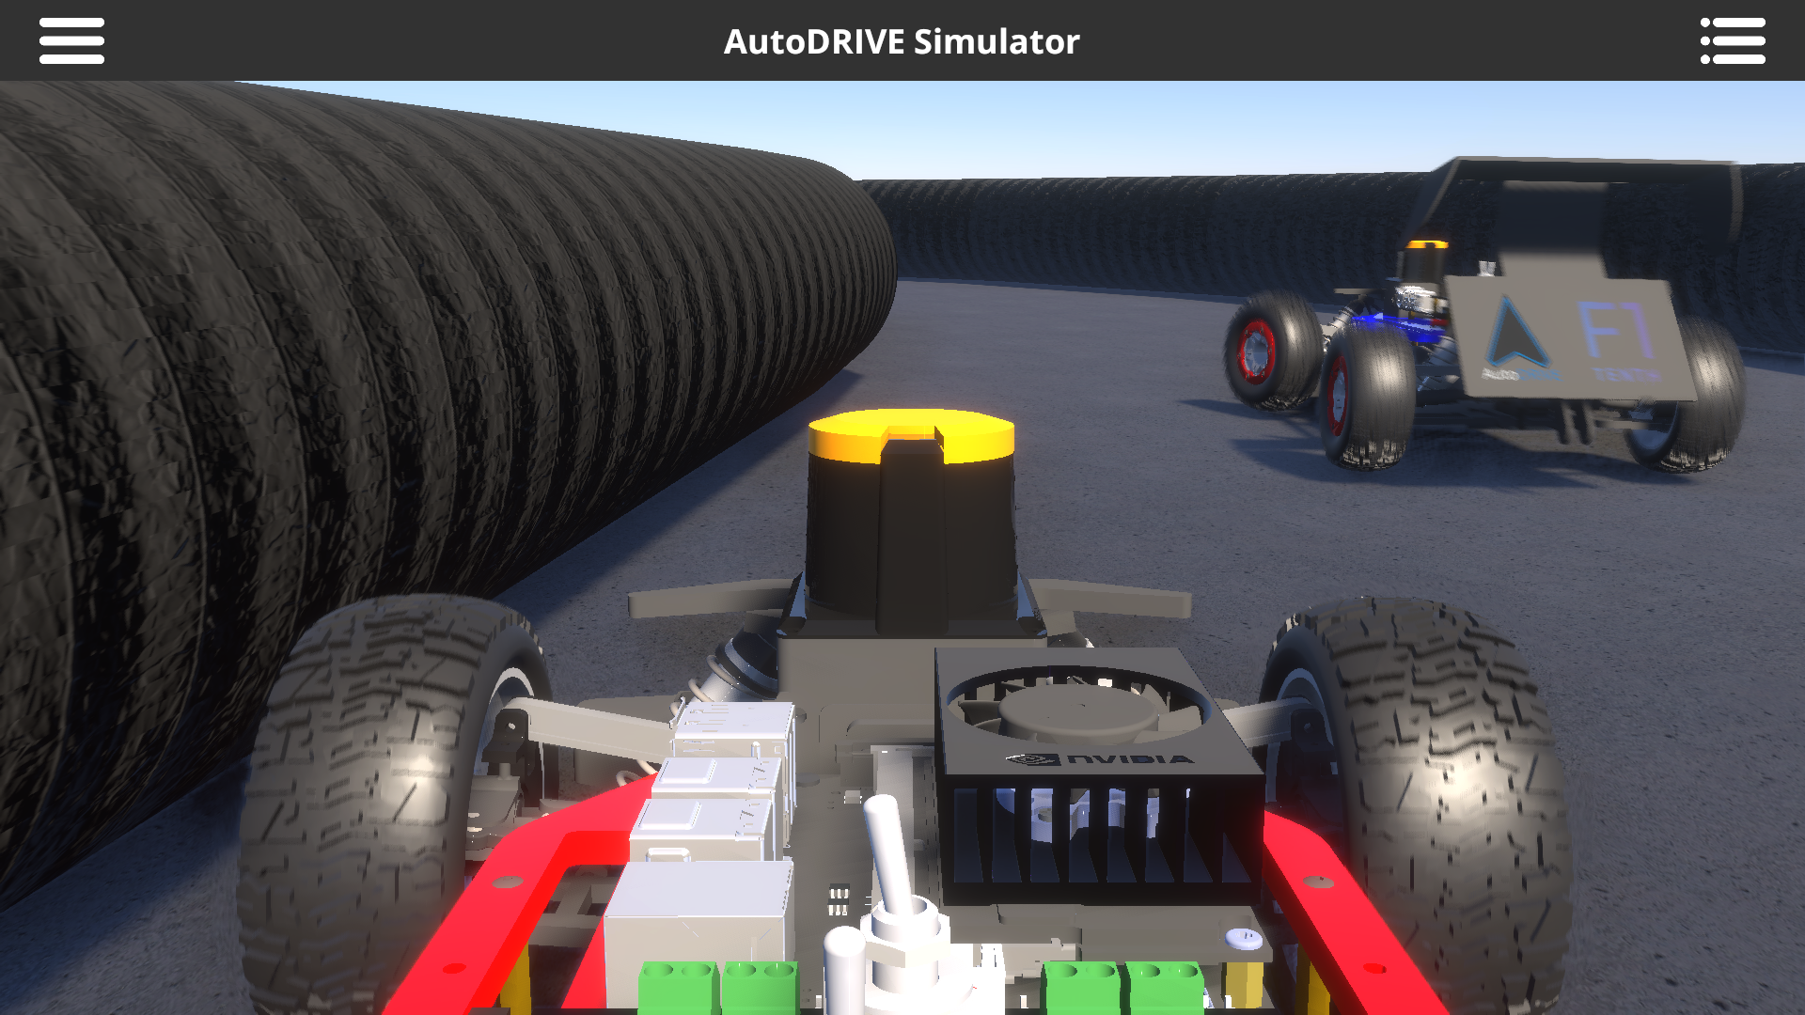
AutoDRIVE Simulator - F1TENTH Simulation

Slide 11
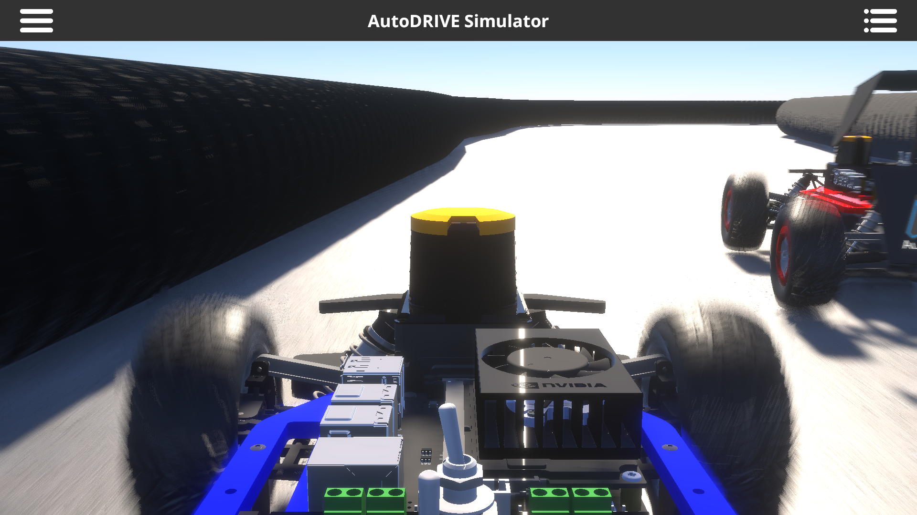
AutoDRIVE Simulator - F1TENTH Simulation

Slide 12
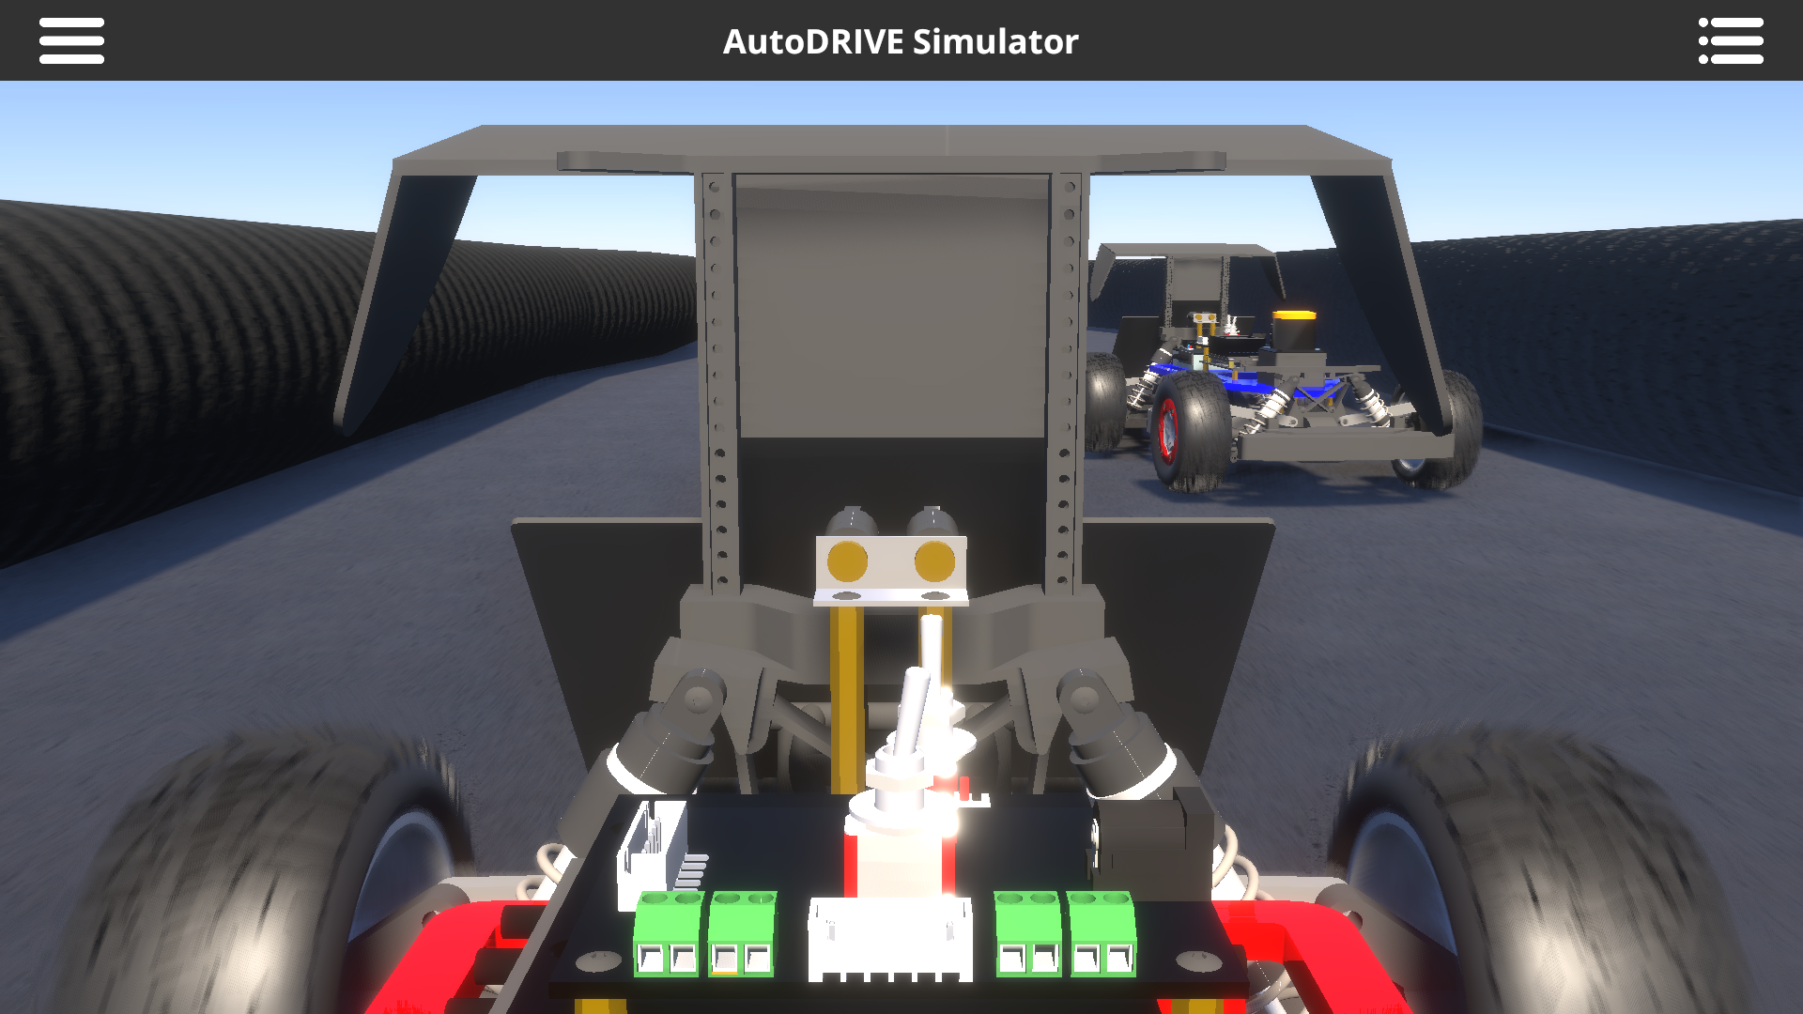
AutoDRIVE Simulator - F1TENTH Simulation

Slide 13
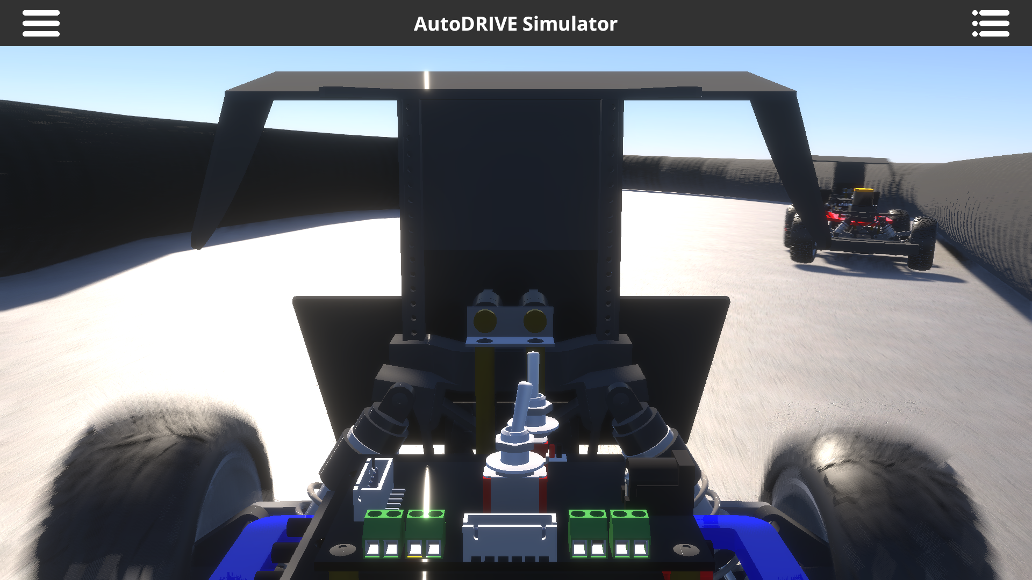
AutoDRIVE Simulator - F1TENTH Simulation

Slide 14
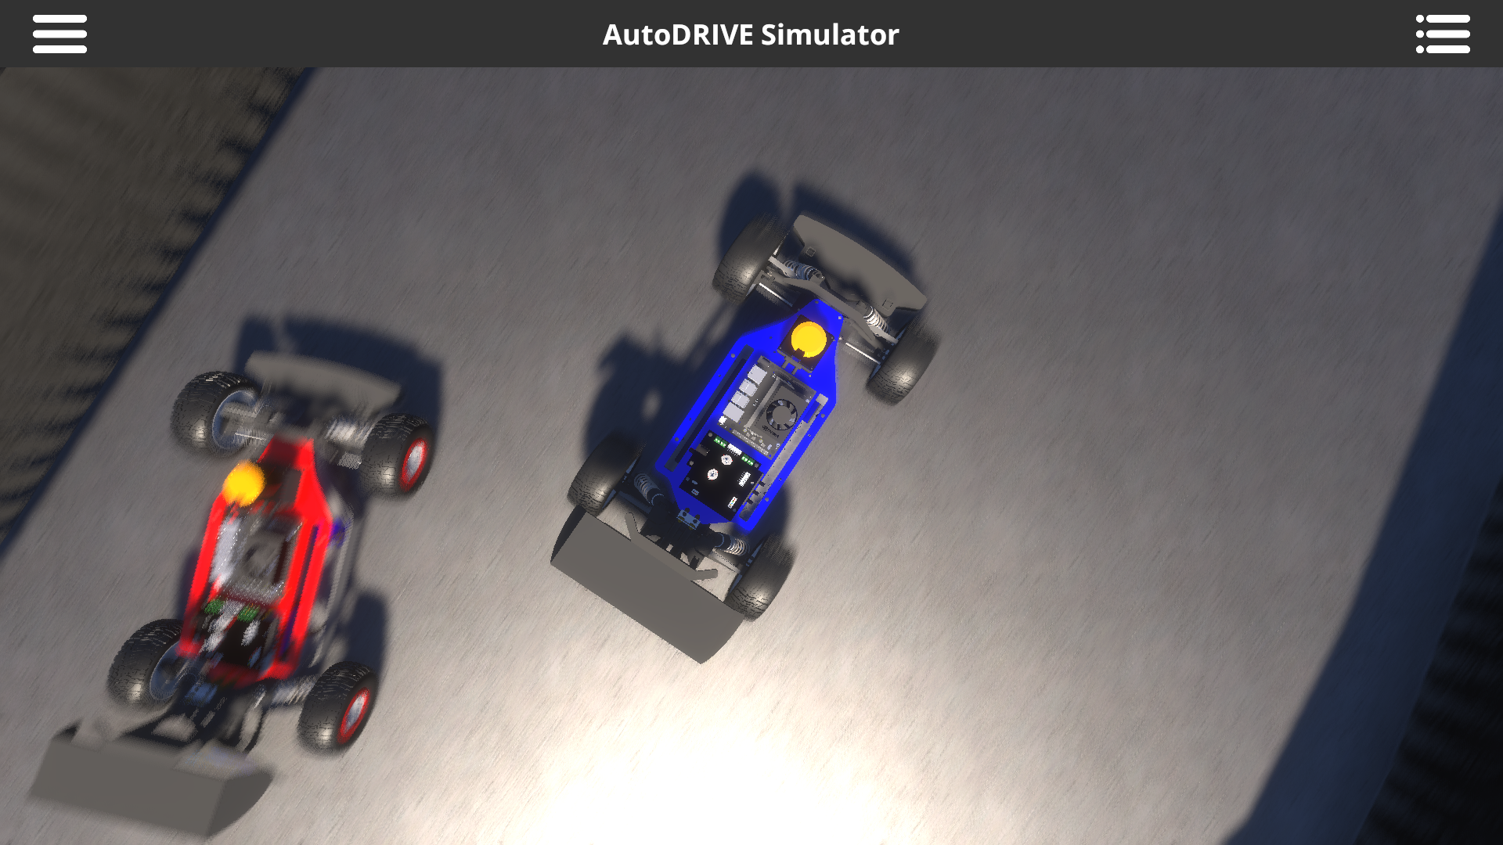
AutoDRIVE Simulator - F1TENTH Simulation

Slide 15
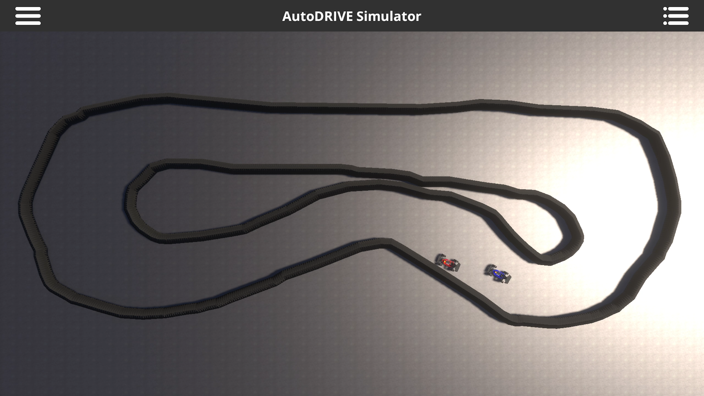
AutoDRIVE Simulator - F1TENTH Simulation

Slide 16
AutoDRIVE Simulator - F1TENTH Simulation
Live Demo!

Slide 17
References
M. Quigley, K. Conley, B. Gerkey, J. Faust, T. Foote, J. Leibs, R. Wheeler, and A. Ng, “ROS: an open-source Robot Operating System,” in ICRA 2009 Workshop on Open Source Software, vol. 3, Jan 2009. [Online]. Available: http://robotics.stanford.edu/~ang/papers/icraoss09-ROS.pdf
S. Macenski, T. Foote, B. Gerkey, C. Lalancette, and W. Woodall, “Robot operating system 2: Design, architecture, and uses in the wild,” Science Robotics, vol. 7, no. 66, p. eabm6074, 2022. [Online]. Available: https://www.science.org/doi/abs/10.1126/scirobotics.abm6074
M. O'Kelly, H. Zheng, D. Karthik and R. Mangharam, “F1TENTH: An Open-source Evaluation Environment for Continuous Control and Reinforcement Learning,” Proceedings of Machine Learning Research, H.J. Escalante R. Hadsell (eds.), Proceedings of the NeurIPS 2019 Competition and Demonstration Track, PMLR, vol. 123, pp. 77-89, December 2020. [Online]. Available: https://proceedings.mlr.press/v123/o-kelly20a.html
T. Samak, C. Samak, S. Kandhasamy, V. Krovi, and M. Xie, “AutoDRIVE: A Comprehensive, Flexible and Integrated Digital Twin Ecosystem for Autonomous Driving Research & Education,” Robotics, vol. 12, no. 3, p. 77, May 2023, doi: https://doi.org/10.3390/robotics12030077

